Slide 1

Revit 2011 API News
Jeremy Tammik
Consulting Analyst
Notes:
AEC Title

Slide 2
Class Objective
You learn
New Revit 2011 API features and how to use them
Basic migration steps and considerations
Overview of new Revit SDK samples
An in-depth look at the Idling event
We do not discuss and assume some knowledge of
How to program in .NET
The basics of the Revit API
Revit product usage
Notes:
This is a class for programmers who already have some familiarity with both the .NET Framework and the Revit .NET API.
We will be looking at using the Revit MEP API to work programmatically with an MEP BIM.

Slide 3

About the Presenter
Jeremy Tammik
Developer Technical Services
EMEA, Autodesk SARL
Jeremy is a member of the AEC workgroup of the Autodesk Developer Network ADN team, providing developer support, training, conference presentations, and blogging on the Revit API.
He joined Autodesk in 1988 as the technology evangelist responsible for European developer support to lecture, consult, and support AutoCAD application developers in Europe, the U.S., Australia, and Africa. He was a co-founder of ADGE, the AutoCAD Developer Group Europe, and a prolific author on AutoCAD application development. He left Autodesk in 1994 to work as an HVAC application developer, and then rejoined the company in 2005.
Jeremy graduated in mathematics and physics in Germany, worked as a teacher and translator, then as a C++ programmer on early GUI and multitasking projects. He is fluent in six European languages, vegetarian, has four kids, plays the flute, likes reading, travelling, theatre improvisation, yoga and carpentry, loves mountains, oceans, sports, and especially climbing.
Notes:
Before we jump into the presentation proper, here’s a little bit about me. My name is Jeremy Tammik, and I work for the Autodesk Developer Network (ADN), in the AEC workgroup. I also write a blog on the Revit API. I have been working with AutoCAD APIs for over twenty years. A key part of my job is to support communication between external plug-in developers and our engineering to help the latter create the APIs that the former need to write really cool add-in applications.

Slide 4
Autodesk Developer Network
Access to almost all Autodesk software and SDK’s
Includes early access to beta software
Members-only website with thousands of technical articles
Unlimited technical support
Product direction through conferences
Marketing benefits
Exposure on autodesk.com
Promotional opportunities
One to three free API training classes
Based on user level
www.autodesk.com/joinadn
Notes:
Some of you may be unfamiliar with ADN. The Autodesk Developer Network is a program providing professional support to programmers writing add-in applications for Autodesk software. If you think the program benefits listed here would be useful to you, then visit this URL and read more about it. You don’t have to be a commercial software developer to join ADN.

Slide 5
Agenda
My first Revit 2011 add-in
Migration of Revit 2010 add-ins
New Revit SDK sample applications
More than 20 new samples
Idling event and samples
RevitWebcam
RST live link
RME loose connectors
Learning More

Slide 6
Acronyms
ADN Autodesk Developer Network
AEC Architecture, Engineering, Construction
API Application Programming Interface
BIM Building Information Model
GUI Graphical User Interface
HVAC Heating, Ventilation, and Air Conditioning
MEP Mechanical, Electrical, and Plumbing
RAC Revit Architecture
RME Revit MEP
RST Revit Structure
SDK Software Development Kit
UI User Interface

Slide 7
Revit 2011 API News
RAC
Improved form generation
Flexible components
RME
Conduits and cable trays
Panel schedules
RST
Concrete joins
Improved analytical model
Platform
User interface
Performance
Reporting parameters
API
Dynamic update
Analysis visualization
Transactions
Iteration
Selection

Slide 8
Major API Renovations
Add-in manifest instead of Revit.ini
DLL split and namespace reorganisation
Transaction mode and regeneration option attributes
New element iteration interfaces
New transaction interfaces
XYZ, UV, and ElementId classes
Symbol class renamed to ElementType
Revit exceptions
AnalyticalModel subclasses removed
EnergyDataSettings replaces gbXMLParamElem

Slide 9
Pipe to Conduit Converter My First Revit 2011 Add-in
Two hundred lines of code, illustrating most major API renovations
Revit API assembly split
Namespace reorganisation
Command registration manifest, guidize.exe
External command Execute method and attributes
Transaction mode
Regeneration option
Task dialogues for user messages
Interactive filtered element selection
Redesigned element filtering
New element creation paradigm
Access to pipe and conduit sizes
p2c.sln
Complete solution and documentation included in class materials
Also available on the web

Slide 10
Migration Steps
Read What's New section in Revit API help doc
Consider which command attributes to use
Update references and namespaces
Accomodate class changes, e.g. app and doc db and ui split
Update element filtering code
Update transaction handling
See http://thebuildingcoder.typepad.com/blog/2010/04/plugin-migration-steps.html

Slide 11
Migration Samples
The Building Coder samples
Revit API introduction labs
diff labs/2010 labs/2011

Slide 12
Major Enhancements
Dynamic Model Update
Elements changed event
Failure API
Select elements, points on elements, faces and edges
Pick point on the view active work plane
Additional ribbon customization options
Revit-style task dialogues
Analysis Visualization Framework
Idling event
Sun and shadows settings
MEP demand factor and load classifications
Panel schedules
Cable tray and conduit

Slide 13
New SDK Samples in Revit 2010
Generic
RaytraceBounce
Ribbon
Revit MEP
AutoRoute
AvoidObstruction
TraverseSystem
Events
AutoStamp
AutoUpdate
CancelSave
EventsMonitor
PrintLog
FamilyCreation
AutoJoin
AutoParameter
CreateAirHandler (rme)
CreateTruss (rst)
DWGFamilyCreation
GenericModelCreation
TypeRegeneration
ValidateParameters
WindowWizard
Massing
DistanceToPanels
MeasurePanelArea
NewForm (5 commands)
PanelEdgeLengthAngle
Notes:
The 23 new samples reflect the main focus of the API development for Revit 2010: family API and conceptual design, ribbon, events, MEP. Events, FamilyCreation and Massing are separate subdirectories, the other samples are located in the main SDK Samples folder. To compile them all, you can use the main solution file. To load them into Revit, you can use the RvtSamples external application. We already discussed the ribbon and events samples. We will look at the family, form creation, and MEP ones in the later sections of the presentation. One sample that does not fall into any of these categories is RaytraceBounce, which demonstrates a new general-purpose model inspection method.

Slide 14
New Revit 2011 SDK Samples
New
AnalysisVisualizationFramework
DistanceToSurfaces
SpatialFieldGradient
ConceptualDesign (* typo)
DividedSurfaceByIntersects
ElementFilter
ViewFilters
FindReferencesByDirection
FindColumns
MeasureHeight
Massing
ParameterValuesFromImage
PointCurveCreation
DirectionCalculation
DocumentChanged
Also known as ChangesMonitor
DynamicModelUpdate
ErrorHandling
ExternalCommand2011
MaterialQuantities
PanelSchedule
Selections
SolidSolidCut
Modified
HelloRevit
ImportExport
TransactionControl

Slide 15
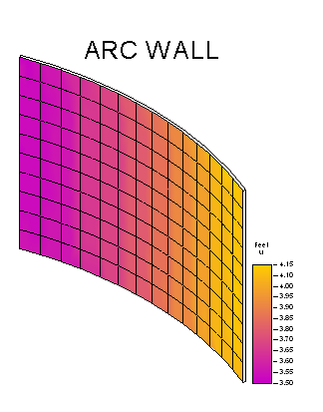
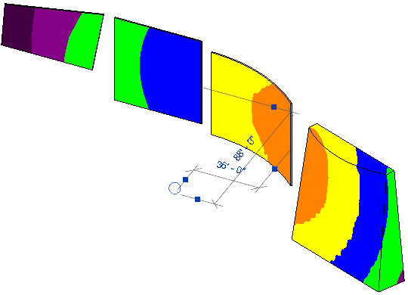
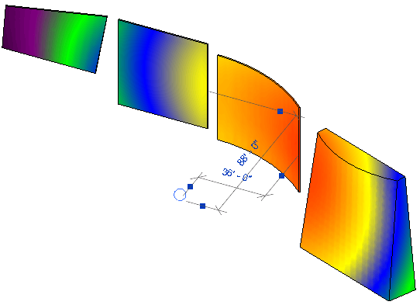
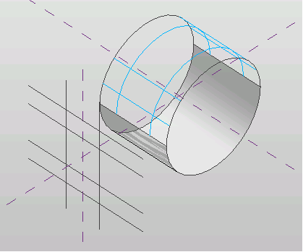
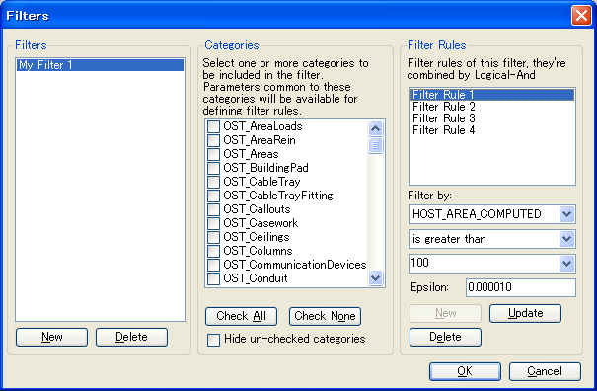
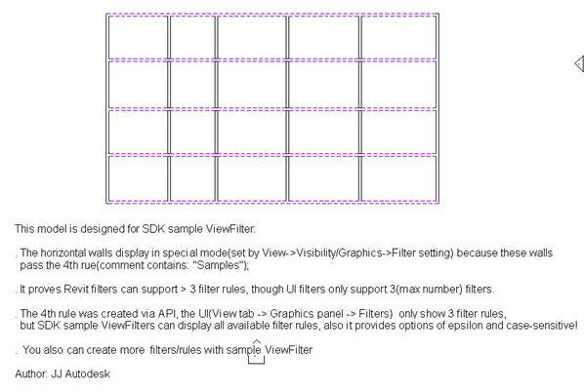
New SDK samples
Analysis Visualization Framework
SpatialFieldGradient
DistanceToSurfaces
Conceptual Design DividedSurfaceByIntersects
ElementFiltering ViewFilters
Notes:
DistanceToSurfaces: external application reacts to changes in walls and sphere object. calculates the distance from a family instance to several points on each face.
SpatialFieldGradient: display analysis results in a Revit model. On selection of a face, this sample displays numeric data on that face. includes legend and colour definition.
DividedSurfaceByIntersects: demonstrates how to add and remove intersection elements such as Level, ReferencePlane, ModelCurve on a DividedSurface.
ViewFilters: demonstrates how to create and modify view filters by 2011 new element iteration API, and show that the API can support more than the three filter maximum imposed by the user interface.

Slide 16
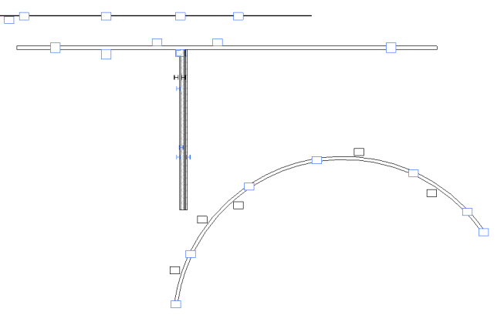
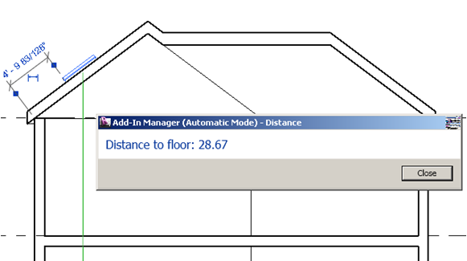
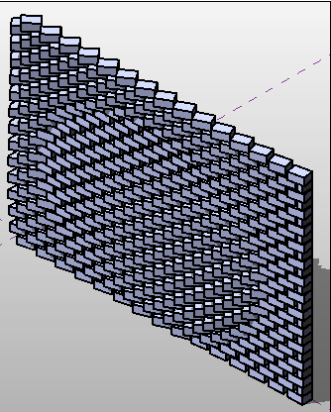

New SDK samples
FindReferencesByDirection
FindColumns
MeasureHeight
Massing
ParameterValuesFromImage
PointCurveCreation
Notes:
FindColumns: demonstrates how to find all walls that have embedded columns in them by shooting a ray along the wall center. Based on Scott's AU 2009 presentation on analysing building geometry.
MeasureHeight: demonstrates how to calculate the height of a selected skylight above the ground floor by shooting a ray with FindReferencesByDirection.
ParameterValuesFromImage: computes a grayscale value for each pixel in an image file. Use this value to set a parameter that will change the model geometry. From Harry's AU 2009 presentation on conceptual design and massing.
PointCurveCreation: seven different examples of using equations and external data files to create point, curve and loft form surface massing geometry.

Slide 17
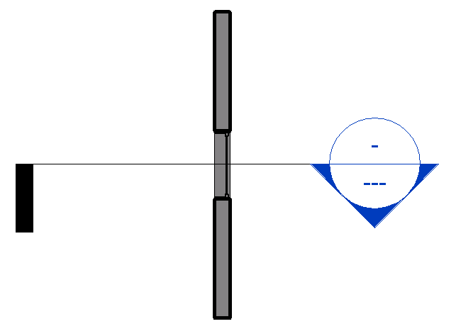
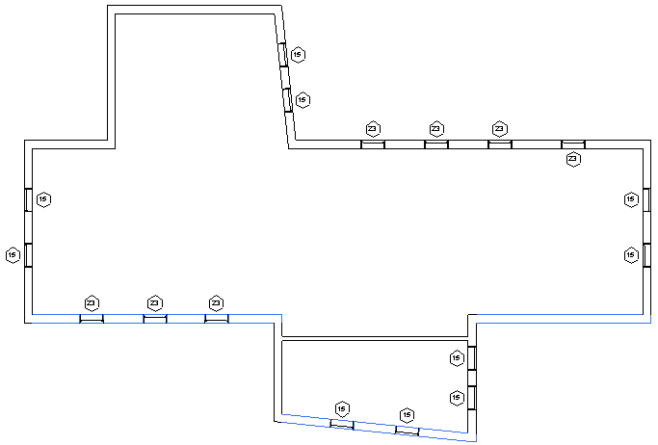
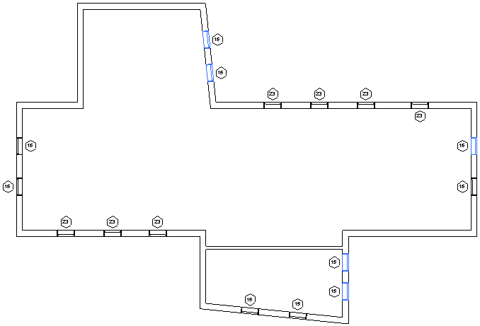
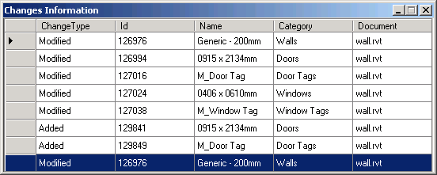
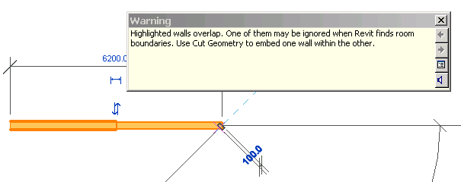
New SDK samples
DirectionCalculation
DynamicModelUpdate
ChangesMonitor
ErrorHandling
Notes:
DirectionCalculation: determine south facing walls and windows by geometrical analysis, with and without considering the project location. Part of Scott's AU 2009 presentation.
ChangesMonitor: demonstrates how to subscribe the DocumentChanged event in an external application and log all modified elements in a modeless dialogue.
DynamicModelUpdate: demonstrates how to maintain relative position between elements by moving a section marker to maintain relative position with a window.
ErrorHandling: implements both a command and an application in the same class to demonstrate how to create failure definition id, failure definition, failure message and how to resolve failures in the failure processing steps.

Slide 18
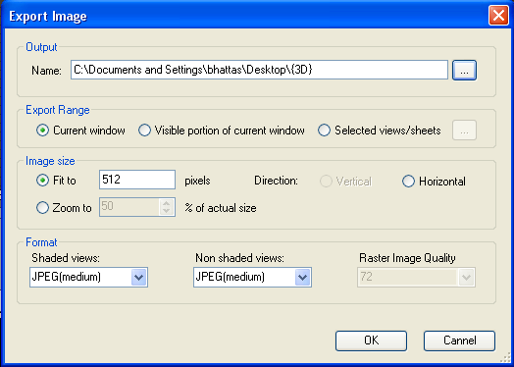
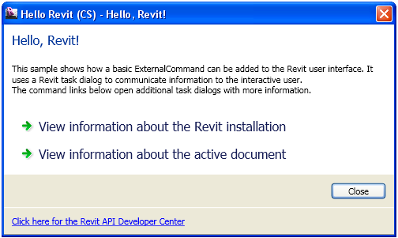
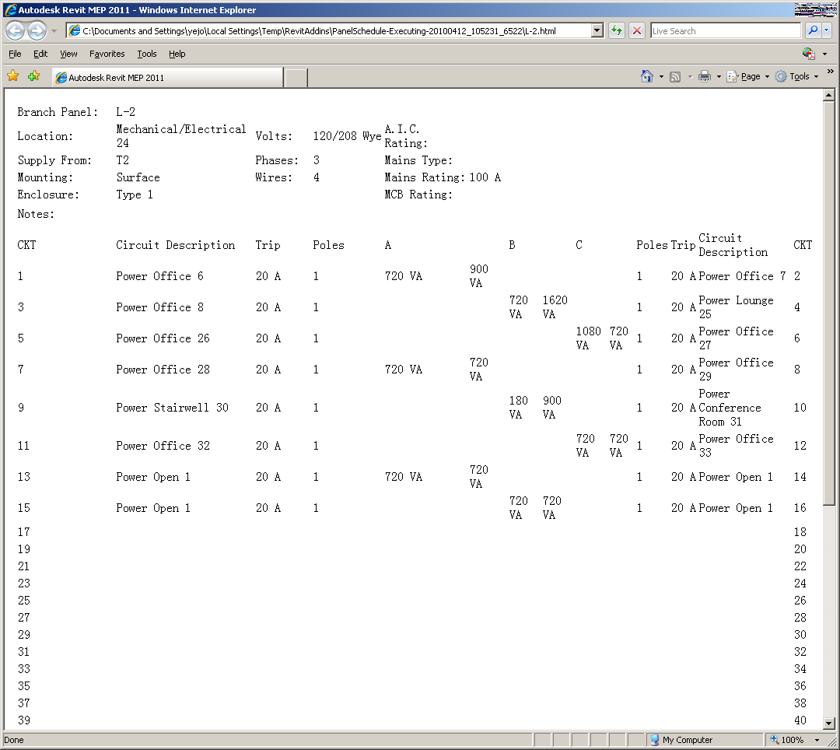
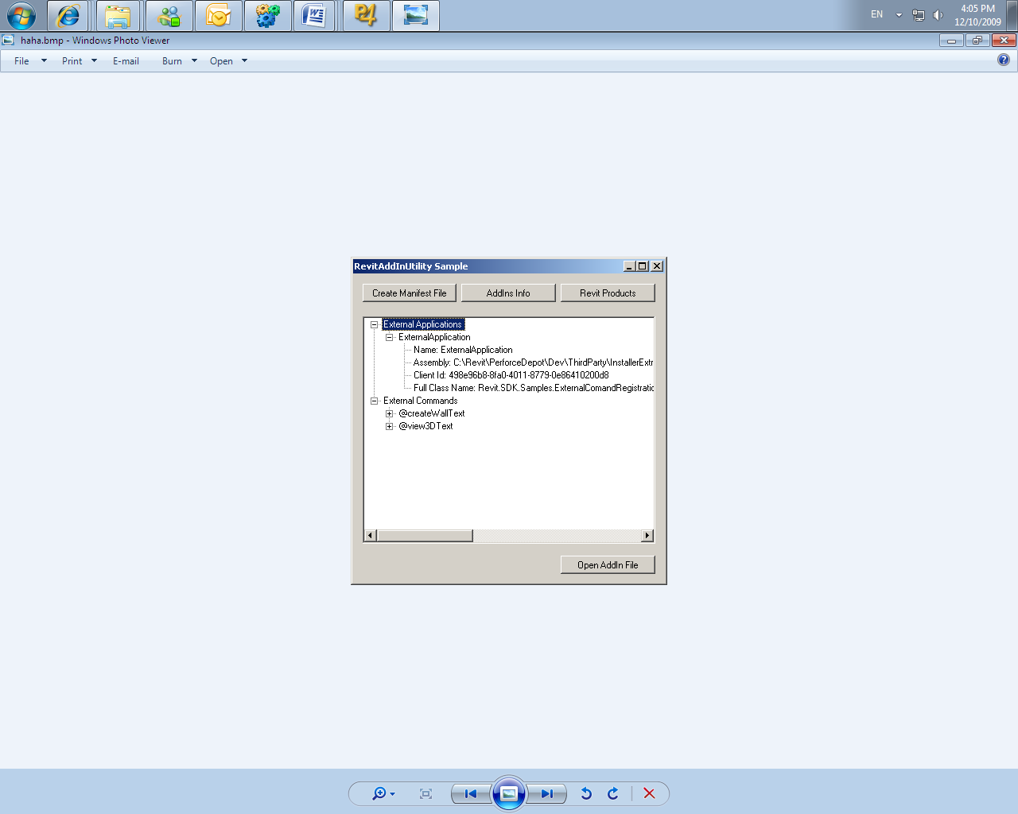
New SDK samples
ImportExport
HelloWorld
ExternalCommand2011
RevitAddInUtility executable
ExternalComandRegistration
MaterialQuantities
Notes:
ExternalCommand2011: a separate solution not included in SDKSamples2011.sln demonstrating how to use the new external command registration and the RevitAddInUtility functionality. it defines an add-in application with two external commands and an external application, as well as a stand-alone installation exe using the Revit add-in utility DLL to read and write a manifest file and analyse the revit installation.
HelloWorld: shows how a basic ExternalCommand can be added to the Revit user interface.
ImportExport: shows how to export current project to dwg, sat,dxf, dwf(x), gbxml, fbx, dgn, image or Civil3D files and how to import a dwg, image, GBXML or Inventor file into Revit.
MaterialQuantities: outputs an analysis of the net and gross material quantities of walls, floors, and roofs to a csv file and displays the output in Excel.

Slide 19
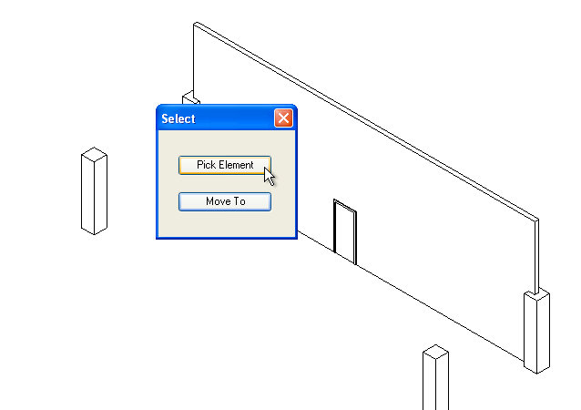
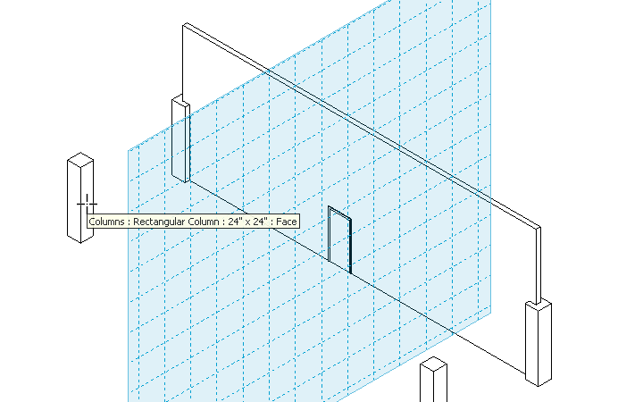
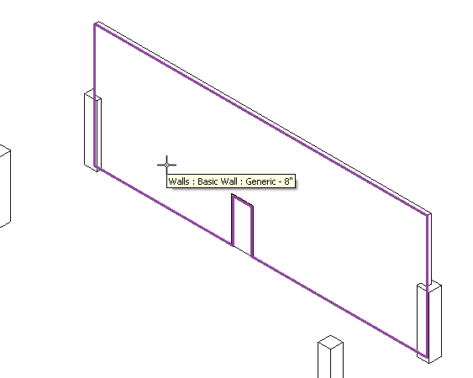
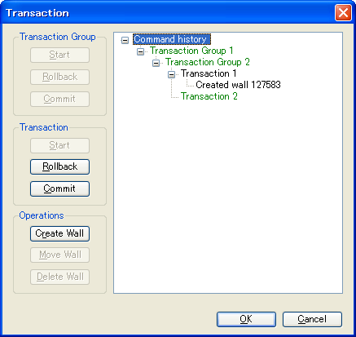
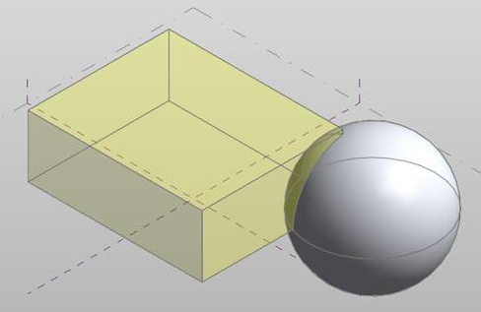
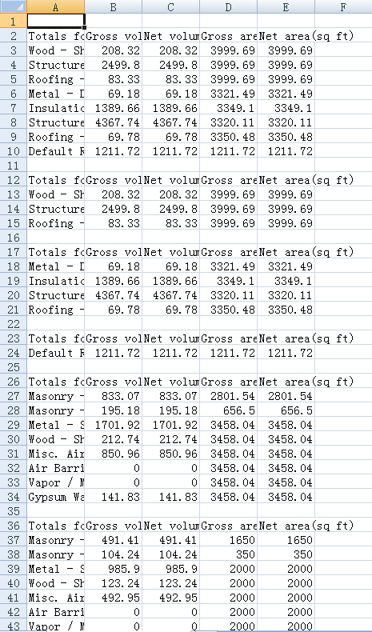
New SDK samples
Selections
SolidSolidCut
TransactionControl
PanelSchedule
Notes:
Selections: imlements four different commands demonstrating how to perform selection operations: element, point on wall face for window placement, face to set work plane and draw a circle, and element or point from dialogue.
SolidSolidCut: shows how to use the new SolidSolidCutUtils class in a conceptual mass family, cut and uncut a sphere from a cube.
TransactionControl: demonstrates how to use transaction group, transaction and sub transaction
PanelSchedule: shows how to use the Revit MEP Panel Schedule API:
1. PanelScheduleExport - gets the panel schedule view data via the API and generate a CSV file or a HTML page from it.
2. InstanceViewCreation - Create a panel schedule view instance for an electrical panel you selected.
3. SheetImport - Place the panel schedule view(s) on a sheet view.

Slide 20
HelloRevit
Complete rewrite of existing sample
How to add an external command to the user interface
Use Revit task dialogue to provide information to user

Slide 21
ImportExport
Exports current project
dwg, sat, dxf, dwf(x), gbxml, fbx, dgn, image or Civil3D file
Imports a dwg, image, gbxml or Inventor file into Revit
New exciting API methods in this context:
DWG can be imported as link: Document.Link()
Identifies if import instance is a link: ImportInstance.IsLinked
New methods to export to ifc, dxf, sat, image files
DWF and DWFX methods were consolidated
Query DWF and IFC export GUID: ExportUtils.GetExportId()
Notes:
Import, export and print changes
Import DWG as link
The method Document.Link() imports a DWG into the document as a link.
Identify if import instance is linked
The property ImportInstance.IsLinked identifies if an import instance element is a link to an external file.
Export option for color mode
The new property ACADExportOptions.Colors allows the option of exporting colors matching the AutoCAD Color Index colors, or as 24-bit true color RGB values.
Export model to IFC
The new method Document.Export(string, string, IFCExportOptions) exports the document to the Industry Standard Classes (IFC) format.
Export model to DXF
The new method Document.Export(string, string, ViewSet, DXFExportOptions) exports the document or set of selected views to the DXF format.
Export model to SAT
The new method Document.Export(string, string, ViewSet, DXFExportOptions) exports the document or set of selected views to the SAT format.
Export image
The new method Document.ExportImage() exports the graphics shown in one or more views to image file(s).
Extract image of an ElementType
The new method ElementType.GetPreviewImage() extracts the preview image of an Element Type. This image is similar to what is seen in the Revit UI when selecting the type of an element. You can specify the size of the image in pixels.
Updated DWF and DWFX export methods
The four 2010 Document.Export methods for exporting of DWF-2D, DWF-3D, DWFX-2D and DWFX-3D files were consolidated into just two methods, one for exporting to DWF format, another to DWFX format. The corresponding export options classes are:
DWFExportOptions
DWFXExportOptions
Both methods can export both 2D views as well as 3D views in one call.
Export id
The static method ExportUtils.GetExportId() retrieves the GUID representing an element in DWF and IFC export. This id is used in the contents of DWF export and IFC export and it should be used only when cross-referencing to the contents of these export formats. When storing Ids that will need to be mapped back to elements in future sessions, UniqueId must be used instead.

Slide 22
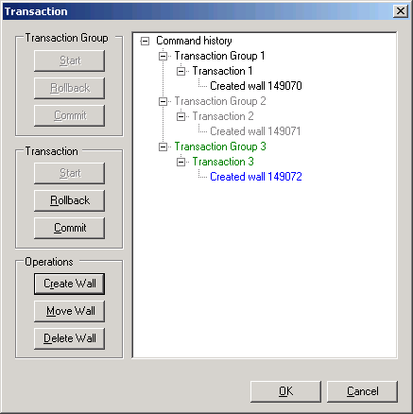
TransactionControl
Completely rewritten from previous version
Demos use of transaction group, transaction and sub transaction
Interactively start, roll back, and commit t-groups and transactions
Create, move or delete walls inside transaction
Tree view displays all operations, transactions and t-groups
T-group and sub-transaction can be nested, transaction cannot

Slide 23
DistanceToSurfaces
Display analysis results in model using dynamic model update
Lives in AnalysisVisualizationFramework subdirectory with SpatialFieldGradient
External application, works with events
On startup, register DocumentOpened event, whose handler:
Checks for the presence of the sphere family and a 3D view named “AVF”
Creates a updater triggereded by wall, mass, or family instance geometry changes
The updater Execute method:
Finds the XYZ location of the sphere
Gets or creates the spatial field manager object
Collects all faces of all walls and masses in the project, including in-place
Calculates the distance between the sphere origin and points on each face
Updates the spatial field primitive to displays these as analysis results on the faces
Notes:
DistanceToSurfaces: external application reacts to changes in walls and sphere object. calculates the distance from a family instance to several points on each face.
SpatialFieldGradient: display analysis results in a Revit model. On selection of a face, this sample displays numeric data on that face. includes legend and colour definition.

Slide 24
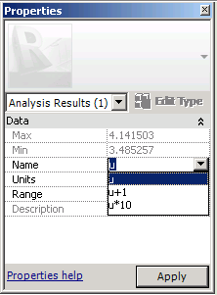
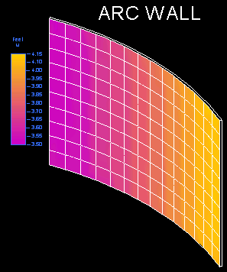
SpatialFieldGradient
Pure analysis visualization framework sample
External command to display numeric data on a selected face
Create AnalysisDisplayColoredSurfaceSettings to show gridlines
Create AnalysisDisplayColorSettings to set min and max colors
Create AnalysisDisplayLegendSettings to specify legend settings
Create analysis display style using these settings and use in active view
Each data point can store multiple values
Data can be displayed in multiple units
Divide the selected face U and V parameterization into 10 segments each
Create three values based on the U value at each point (U, U + 1, U * 10)
Update the spatial field primitive to show this data on the face

Slide 25
DividedSurfaceByIntersects
ConceptualDesign subdirectory (typo fixed)
Massing folder in SDK solution file, Families group in RvtSamples
Demonstrates how to add and remove intersects to DividedSurface
Intersection elements can be Level, ReferencePlane, ModelCurve, etc.

Slide 26
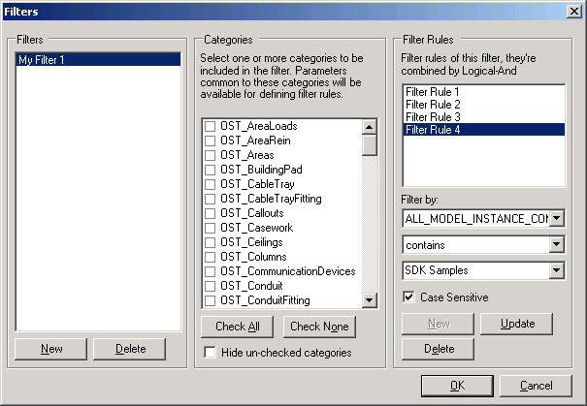
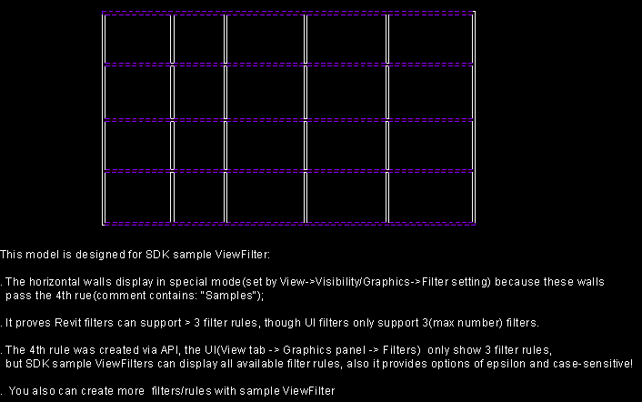
ViewFilters
Create and modify view filters
Simulate functionality of UI command View > Filters
Allows adding more than three filter rules
Sample project contains filter with four rules and some walls fulfilling it
Notes:
ElementFilter/ViewFilters

Slide 27
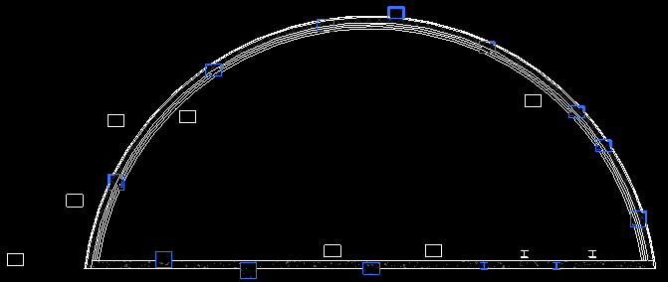
FindColumns
FindReferencesByDirection example
Geometric analysis based on wall location line
Shoot rays 1 foot above wall level along each side of wall
Determine all columns intersected by ray
Split curved walls into segments
Handle all or pre-selected walls
Select all columns found

Slide 28
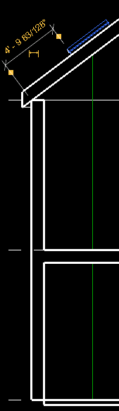
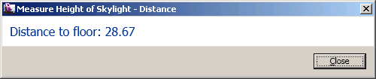
MeasureHeight
Another FindReferencesByDirection example
Measure height of skylight window above ground level
Find a 3D view to use with FindReferencesByDirection
Check if a roof-hosted window is selected
Calculate window height above ground floor (hard-coded element id)
Use window bounding box center as the ray start point
Run FindReferencesByDirection using the negative Z direction
Find the closest reference belonging to the floor
Report result and create a model curve to show the ray found

Slide 29
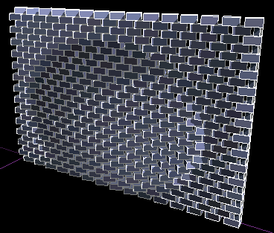
ParameterValuesFromImage
ParameterValuesFromImage and PointCurveCreation massing samples
Set parameter values based on image data
Compute a grayscale value for each pixel in an image file
Each panel's 'Grayscale' parameter is set to the corresponding value
Geometry is updated based on this

Slide 30


PointCurveCreation
Massing sample showing reference points and curve by points creation
Use equations and external data files to create massing geometry
PointsParabola - create reference points following parabolic arcs, e.g. z = x^2
PointsOnCurve - create reference points constrained to a model curve, based on PointOnEdge elements, so they maintain their relative position if the curve is modified
PointsFromExcel - create reference points based on XYZ data in an Excel file
PointsFromTextFile - create reference points based on comma-delimited text file
SineCurve - create curve based on points placed using the equation y = cos(x)
CatenaryCurve - ditto using y=ScalingFactor * CosH(x/ScalingFactor)
CyclicSurface - create loft form based on curves and points created using the equation z = cos(x) + cos(y)

Slide 31
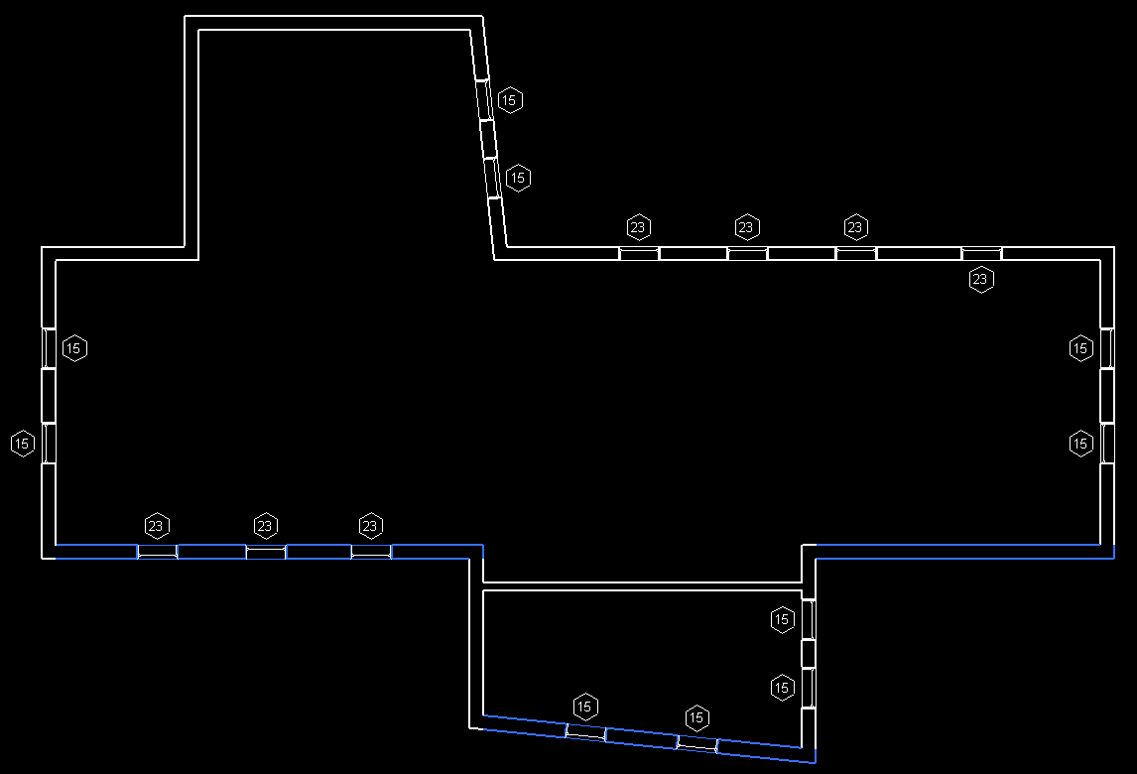
DirectionCalculation
Identify orientation of building elements
Find and select all windows and exterior walls facing south
Optionally take project location into account, else use Y axis
Find the exterior walls using the wall type Function parameter
Determine wall direction from location curve
Optionally transform direction by ActiveProjectLocation rotation angle
Wall is 'south-facing' if its direction points south +/- 45 degrees
Windows use FamilyInstance class and OST_Windows built-in category
Direction can be determined from window instance transform and the FacingFlipped and HandFlipped properties
Alternatively use FacingOrientation property

Slide 32
ChangesMonitor
Subscribe to the Application.DocumentChanged event
Raised after every transaction is committed, undone, or redone
Read-only event unlike dynamic model update
Important event argument properties and methods
Operation: the operation associated with this event
GetDocument: the document associated with this event
GetAddedElementIds: the set of newly added elements
GetDeletedElementIds: deleted elements
GetModifiedElementIds: modified elements
GetTransactionNames: associated transaction names

Slide 33
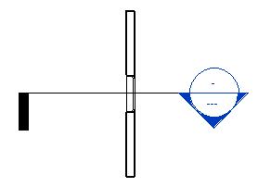
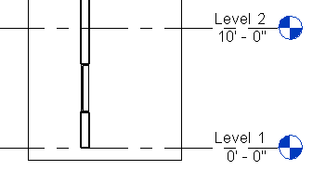
DynamicModelUpdate
Modify Revit model as a reaction to changes
Implement an updater, add a trigger, define scope and type
Scope can be specific element ids or result of an element filter
Type can be element addition, deletion, modification of geometry, parameters, or any property
Sample works in AssociativeSection.rvt
Maintains section view positioned to display a cut through a window and the host wall

Slide 34
ErrorHandling
Demonstrate use of the new Failure API
Simplest use: suppress a specific warning message
Define and post failures from API
Respond to failures posted by Revit and API code
Create failure definition id, failure definition, failure message
Different severities and resolution types
Create failure message and post it
Resolve failures in failure processing steps
During failure pre-processor
In failure processing event
During failure processor

Slide 35
ExternalCommand2011
Two separate applications demonstrating
External command registration functionality
Revit add-in utility
ExternalComandRegistration
Visibility mode depends on product and document type, e.g.
IAvailabilityClass: enable and disable command programmatically
Define command icon and tooltip
Localisation resource DLL, e.g. Chinese and English images and text
RevitAddInUtilitySample
Retrieve Revit product installation information
Read, create and edit add-in manifest file

Slide 36
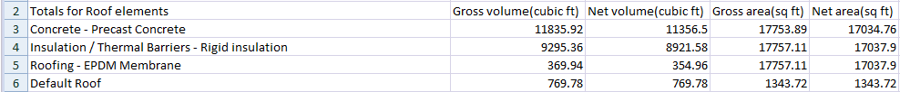
MaterialQuantities
Material quantity data extraction using Element properties
Materials – list materials within an element
GetMaterialVolume – volume of a particular material
GetMaterialArea – area of a particular material
Algorithm
Collect all roof elements
Iterate through each material found in each roof
Find the net volume and area of the material
Store the material quantities
Write the results to the output file
Find the gross material quantities
Start a new transaction, delete the elements that cut the host (doors, windows, openings), find the volume and area for each material, store the material quantities, write the results to the output file, rollback the transaction
Repeat the above steps for walls and floors
Open the output file in Microsoft Excel

Slide 37
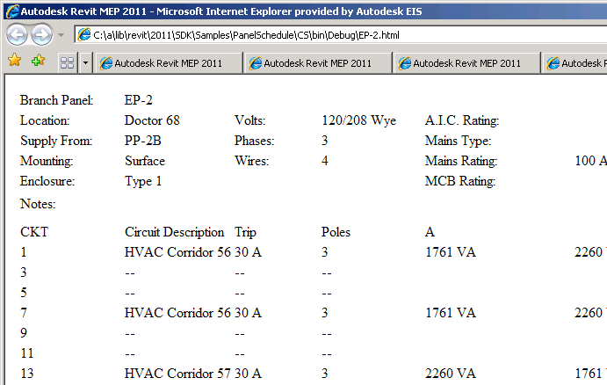
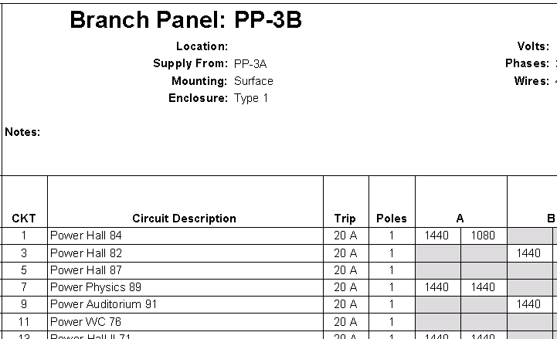
PanelSchedule
Data exchange sample showing use of the Panel Schedule API
PanelScheduleExport reads data and exports it to CSV or HTML
InstanceViewCreation creates a panel schedule view instance for a selected panel
SheetImport places all panel schedule views on a sheet
Notes:
PanelSchedule: shows how to use the Revit MEP Panel Schedule API:
1. PanelScheduleExport - gets the panel schedule view data via the API and generate a CSV file or a HTML page from it.
2. InstanceViewCreation - Create a panel schedule view instance for an electrical panel you selected.
3. SheetImport - Place the panel schedule view(s) on a sheet view.

Slide 38
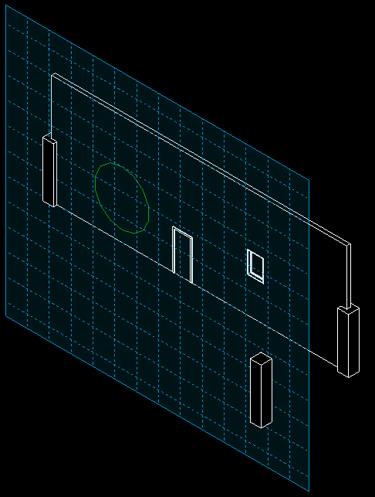
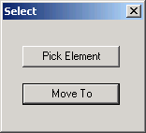
Selections
Demonstrate new selection operations
Four different commands
Pick elements for deletion
Pick element or point from dialogue
Pick face to set work plane and draw a circle
Pick point on wall face for window placement
Notes:
Selections: imlements four different commands demonstrating how to perform selection operations: element, point on wall face for window placement, face to set work plane and draw a circle, and element or point from dialogue.

Slide 39
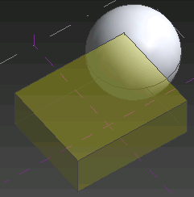
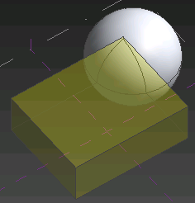
SolidSolidCut
New SolidSolidCutUtils class
IsAllowedForSolidCut – is element eligible?
CanTwoElemsHaveSolidSolidCut – can cut be added to two elements?
AddCutBetweenSolids – create the solid-solid cut for two elements
GetCuttingSolids – return solids which cut input element
GetSolidsBeingCut – return solids being cut by input element
RemoveCutBetweenSolids – uncut, i.e. remove the solid-solid cut
Works in conceptual mass family
Works on generic forms, geometry combinations, family instances
Sample add-in defines two commands, Cut and Uncut
To be run on a sample model using hard-coded element ids
Notes:
SolidSolidCut: shows how to use the new SolidSolidCutUtils class in a conceptual mass family, cut and uncut a sphere from a cube.

Slide 40
The Idling Event and Samples
UIApplication.Idling event is raised between user interactions
Safe for API to access document, transaction may be opened
Interaction with an external application is possible
Synchronisation logic required
RevitWebcam sample
Select a Revit element face in the model and specify image url
In the Idling event handler, poll the internet image updates
Display grayscale results on the face in the Revit model using AVF
RstLiveLink sample
Export RST analytical model to external analysis application
In the Idling event handler, check for updated file timestamp
Import modified data back into Revit model
Journaling issue

Slide 41

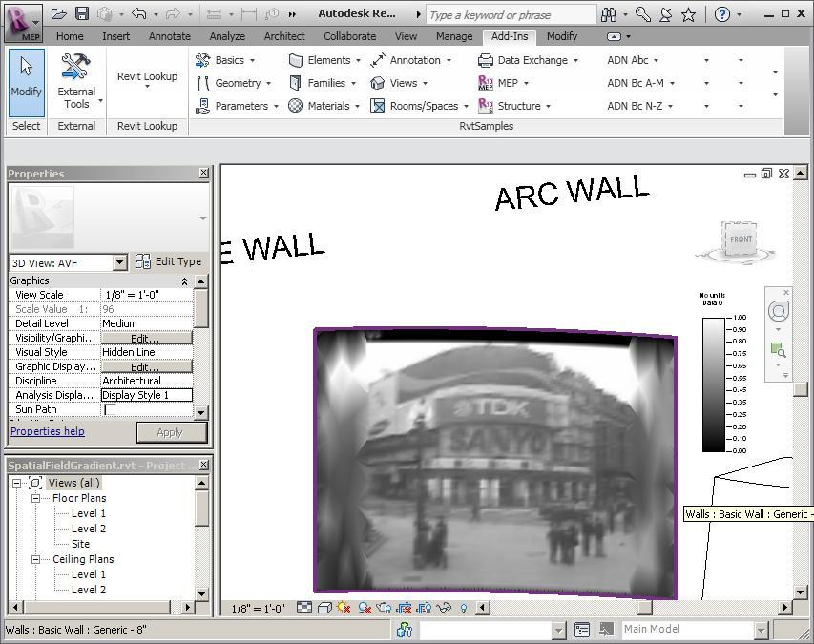
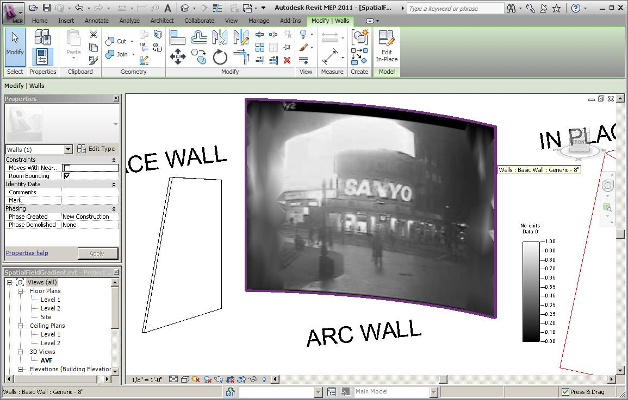
RevitWebcam
Idling event and analysis visualisation sample
Implemented as an external command
Select face on BIM element using filter
Set up a spatial field primitive for face
Set greyscale analysis display style
Subscribe to Idling event with handler to
Check minimum elapsed time interval
Grab current image from URL
Check whether update required
Start transaction for write access
Update spatial field primitive
Set field points and values
RevitWebcam.sln

Slide 42
RstLink Dynamic Update
Idling event and Revit Structure link sample
RstLink demonstrates export of analytical model to an external application and import of modified results back into Revit
Export from Revit to neutral exchange file format
Import into external analysis application and recreate simplified model
Edit and export modified model from external analysis application
Import back into Revit
RstLiveLink automates the synchronisation
Export command saves model to external file, remembers timestamp and installs Idling event handler
Idling handler checks for an updated exchange file, starts transaction, imports updated data, updates timestamp

Slide 43
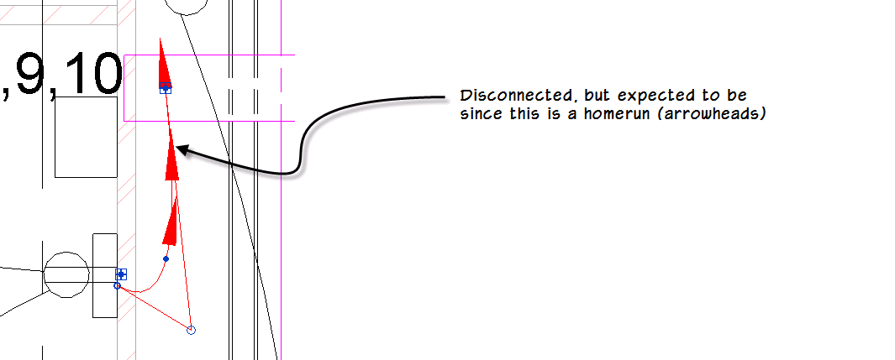
Modeless Loose Connector Navigation
Filter for all MEP connectors in project
Combine all relevant classes and family instance categories
Check IsConnected property on each connector
Unable to determine whether a wire is intended to be homerun
Log results to file and display it to user
Interactively navigate through results from a modeless dialogue
Ensure that modeless dialogue remains on top of Revit
Modeless navigation interacts with Idling event
LooseConnector.sln

Slide 44
Materials
RAC_2011_API_News.pptx – presentation
p2c – my first Revit 2011 add-in
rac_labs and bc – code migration samples
RevitWebcam – Idling event and AVF sample
RstLiveLink – Idling event and RST link sample
Modeless Loose Connector Navigation
Revit_SDK_Samples.xlsx

Slide 45
Learning More
Online Help, Developer's Guide and SDK Samples
Revit Developer Center
http://www.autodesk.com/developrevit
DevTV Introduction to Revit Programming
Webcasts and Trainings on Revit Programming and News
http://www.adskconsulting.com/adn/cs/api_course_sched.php > Revit API
Discussion Group
http://discussion.autodesk.com > Revit Architecture > Revit API
API Training Classes
http://www.autodesk.com/apitraining
The Building Coder, Jeremy Tammik's Revit API Blog
http://thebuildingcoder.typepad.com
ADN, The Autodesk Developer Network
http://www.autodesk.com/joinadn
DevHelp Online for ADN members
http://adn.autodesk.com

Slide 46


